Slide 1
Classifying Stars using Artificial Intelligence
Rosie Fasullo
Notes:
We classify stars to learn something about their physical properties

Slide 2
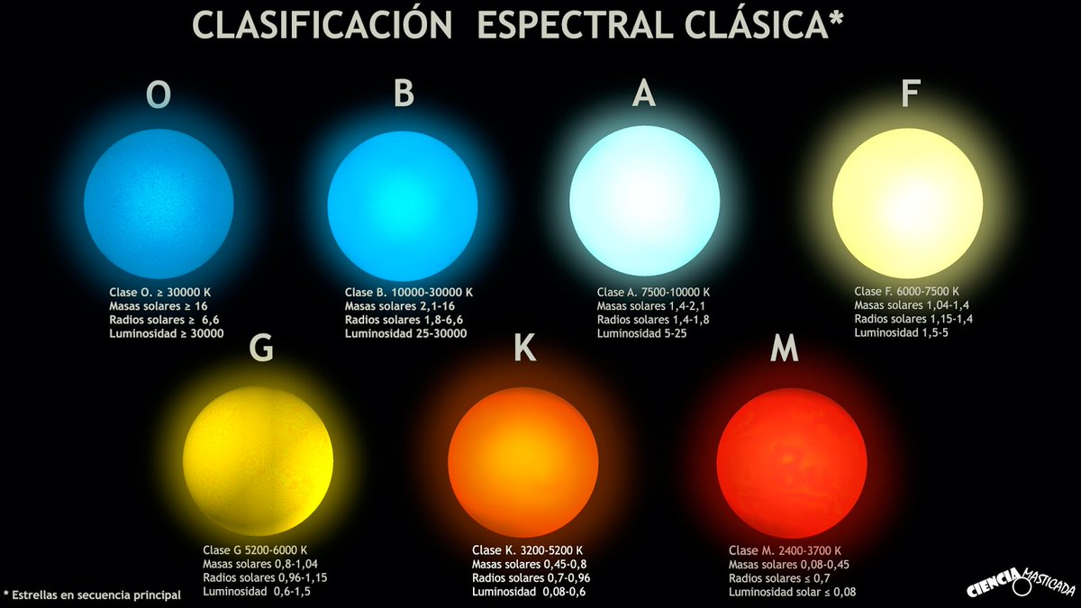
Spectral Type corresponds to temperature
Type O: >30000K
(Hottest)
Type B: 10000-30000 K
Type A: 7500-10000 K
Type F: 6000-7500 K
Type G: 5200-6000 K
(The Sun)
Type K: 3200-5200 K
Type M: 2400-3700 K
(Coolest)
http://frasesparatatuajes.club/estrellas-nombres/25496/
Notes:
http://frasesparatatuajes.club/estrellas-nombres/25496/

Slide 3
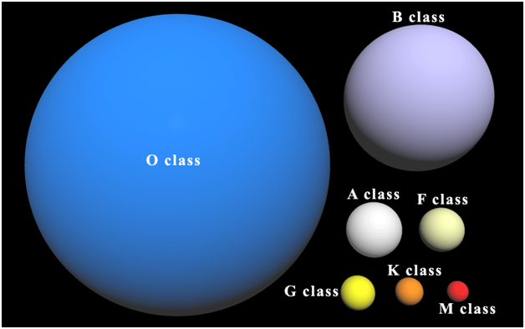
Luminosity Class Corresponds to size
Class II
Class I
Class III
Class IV
Class V
(The Sun)
http://www.guildcompanion.com/scrolls/2011/oct/ssg03.html

Slide 4
Stellar Classifications are broken down into two parts
B3 IV
Spectral Type
Luminosity Class
Subtype

Slide 5
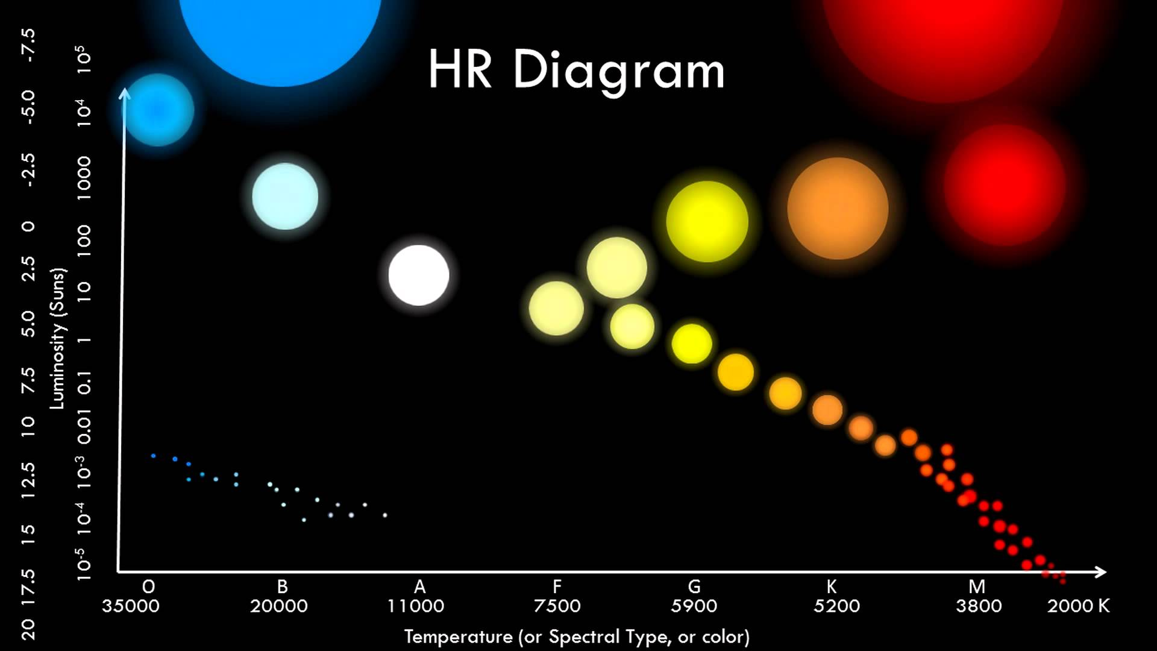
Hertzsprung-Russell Diagram
The Sun
https://i.ytimg.com/vi/588oz17Xj8o/maxresdefault.jpg

Slide 6
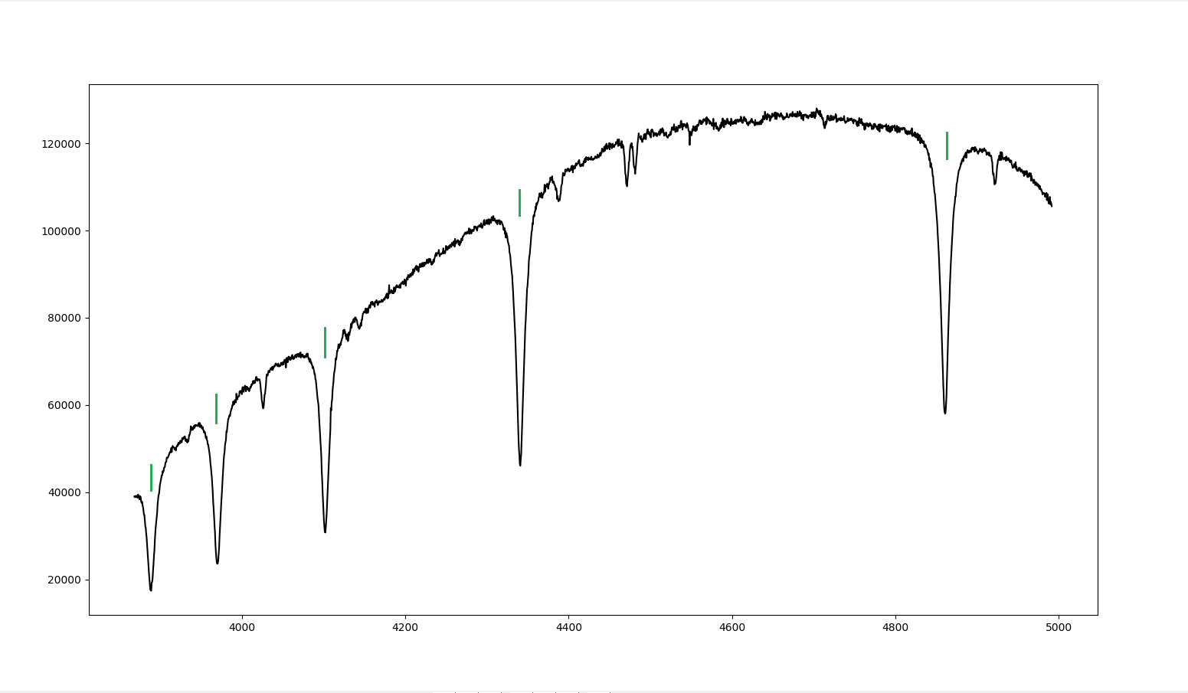
A spectrum is a continuum of light emitted by an object
HD023288
120000
100000
80000
Luminosity (ADU)
60000
40000
20000
4000
4200
4400
4600
4800
5000
Wavelength (Å)

Slide 7
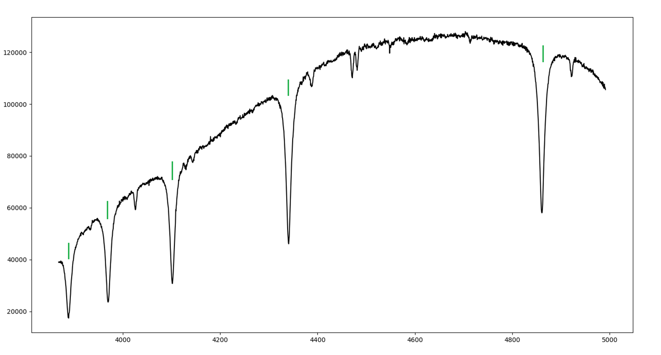
The most important absorption lines are the balmer hydrogen lines
HD023288
Hβ
120000
Hγ
100000
80000
Hδ
Luminosity (ADU)
Hε
60000
H8
40000
20000
4000
4200
4400
4600
4800
5000
Wavelength (Å)

Slide 8
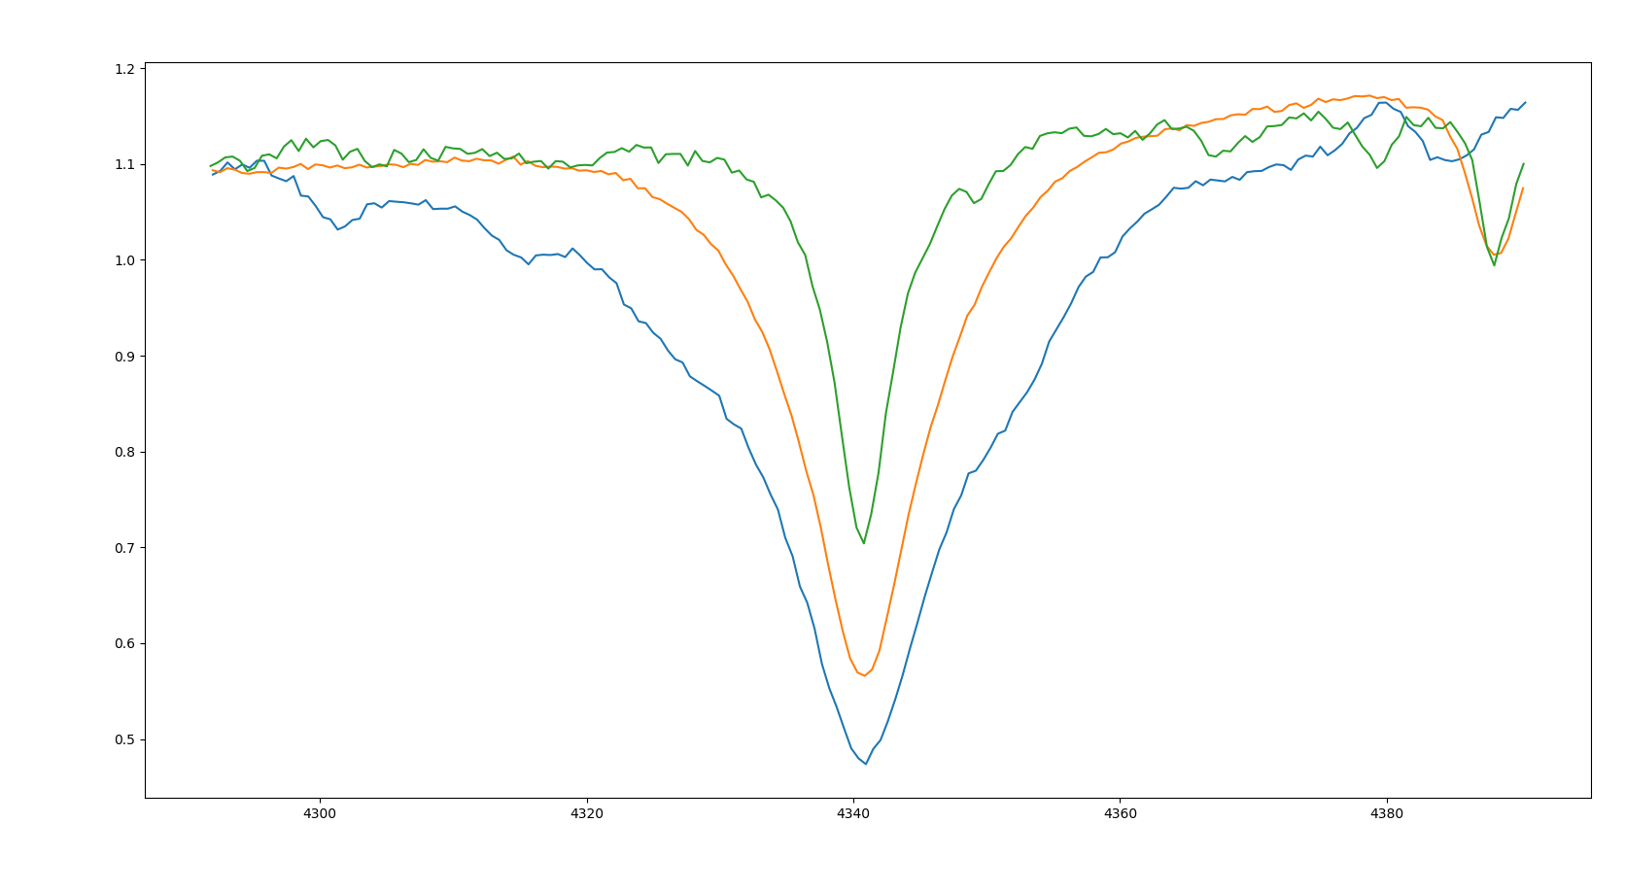
Spectral type is determined by width of the hydrogen lines
Hγ
1.2
O9 V
1.1
1.0
0.9
Relative Intensity (ADU)
0.8
B3 V
0.7
A3 V
0.6
0.5
4300
4320
4340
4360
4380
Wavelength (Å)

Slide 9
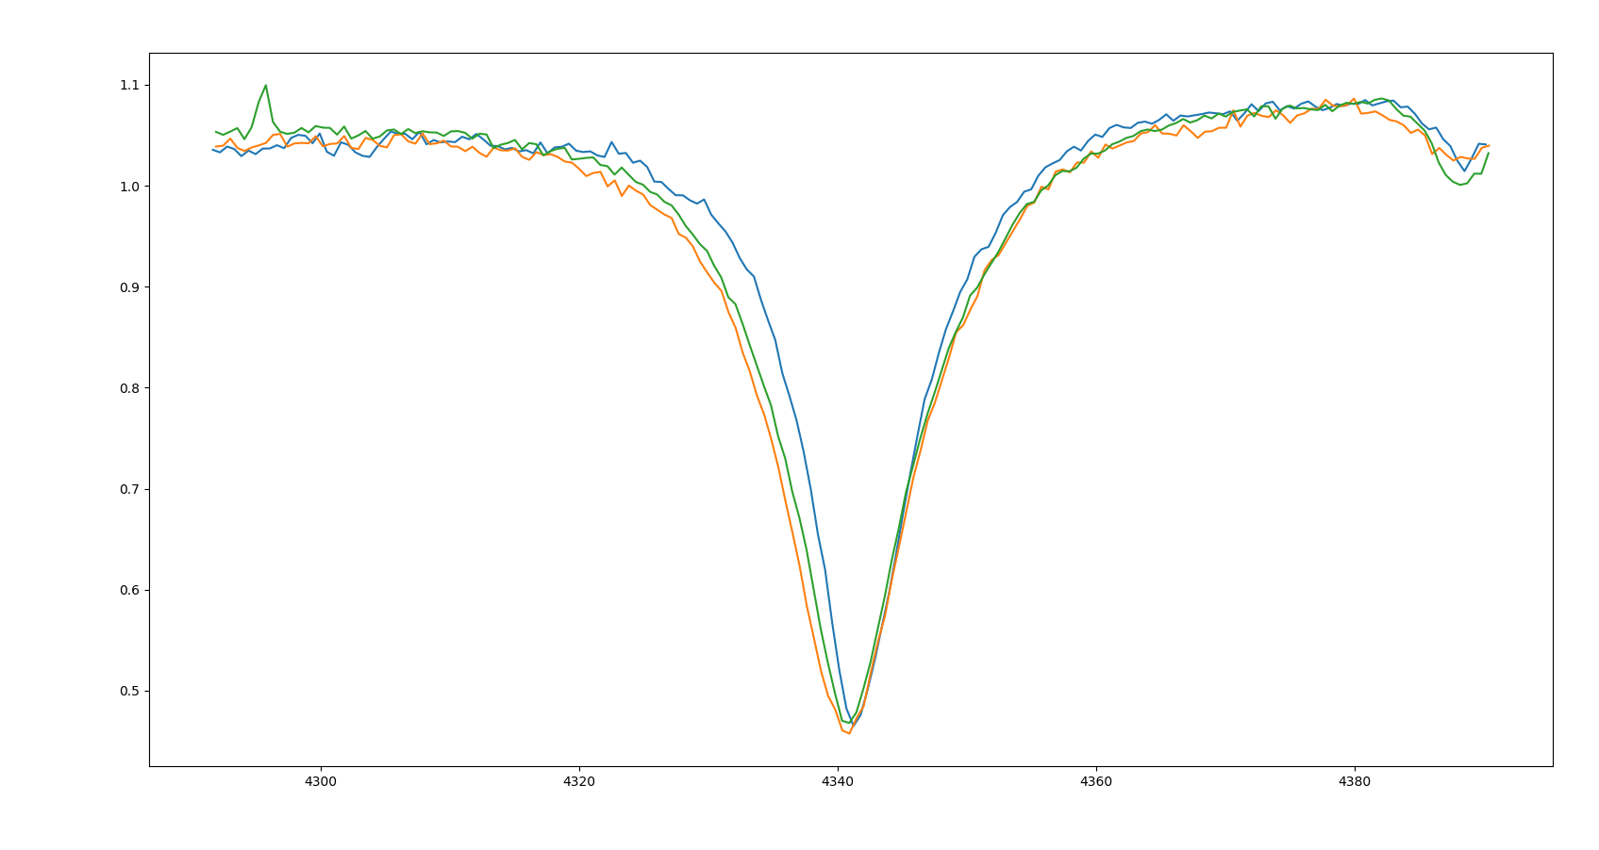
Luminosity class is determined by the shape of the hydrogen wings
1.1
B7 III
1.0
B7 IV
0.9
0.8
Relative Intensity (ADU)
B7 V
0.7
0.6
0.5
4300
4320
4340
4360
4380
Wavelength (Å)

Slide 10
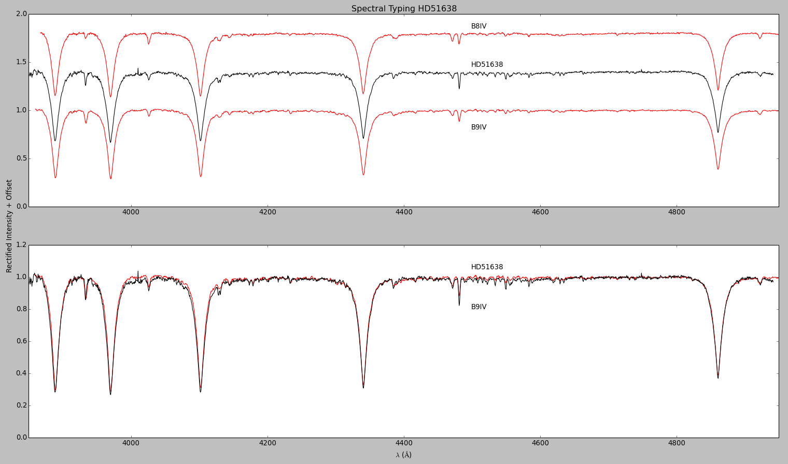
Stars are usually classified by comparing their spectra
Notes:
Not fit – fit (make this two slides)

Slide 11
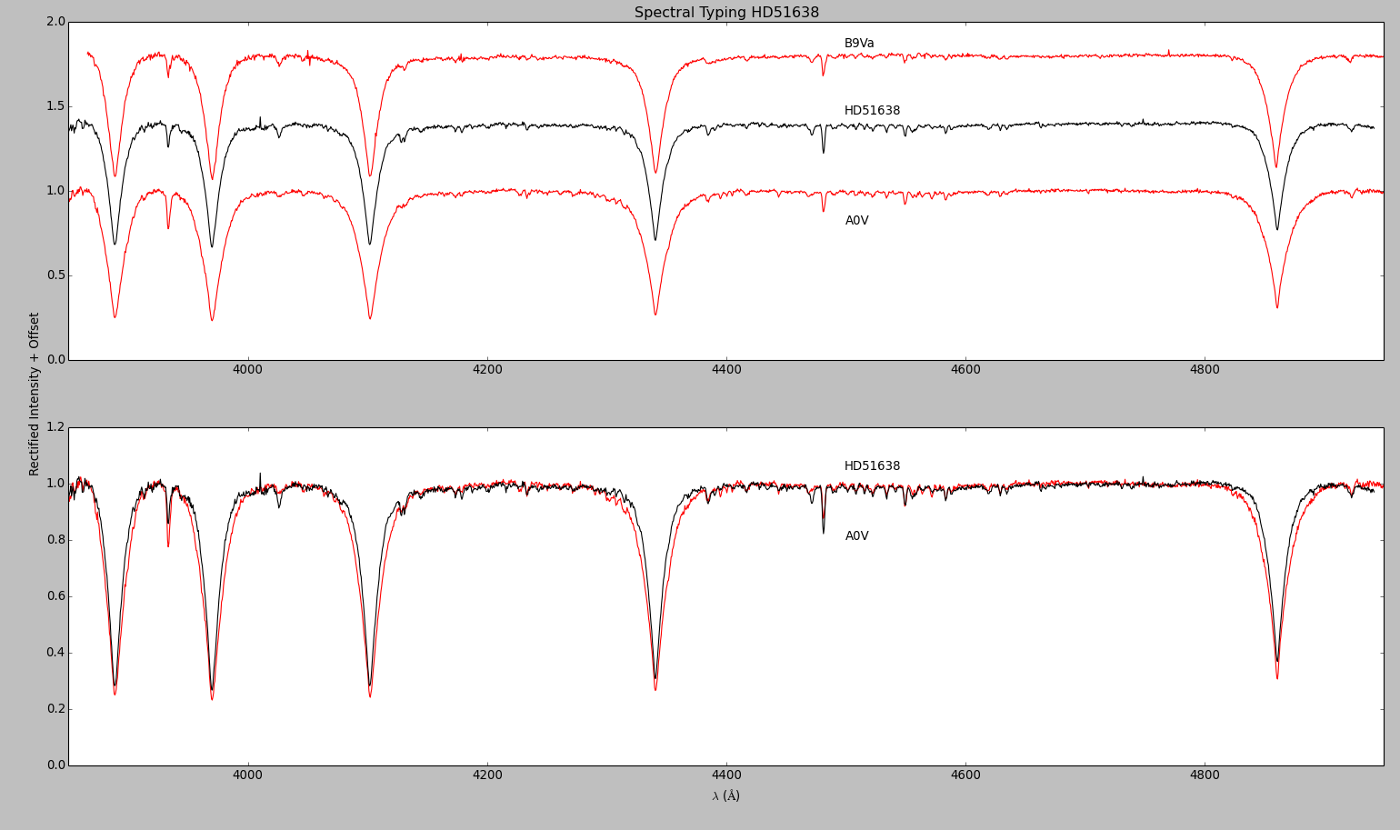
Stars are usually classified by comparing their spectra
Notes:
Not fit – fit (make this two slides)

Slide 12
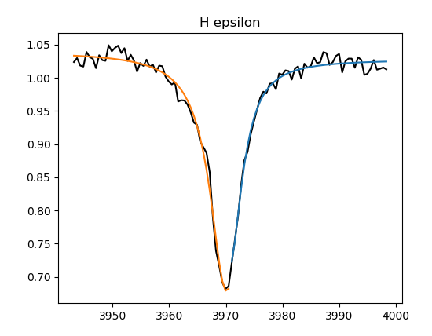
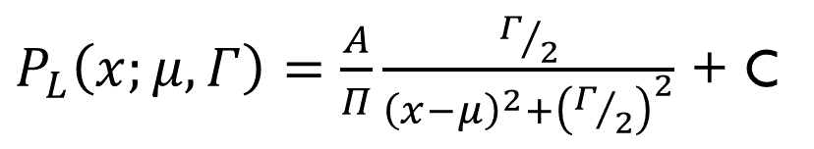
The Lorentz distribution describes the shape and strength of the hydrogen lines
$P_{L}\left(x;μ,Γ\right)=\frac{A}{Π}\frac{Γ/2}{{\left(x−μ\right)}^{2}+{\left(Γ/2\right)}^{2}}$ + C
Luminosity (ADU)
Lorentz Curve
Wavelength (Å)
Notes:
Add the formula

Slide 13

A computer can work much faster than a human
https://becominghuman.ai/what-is-artificial-intelligence-ai-4bde325e5462

Slide 14
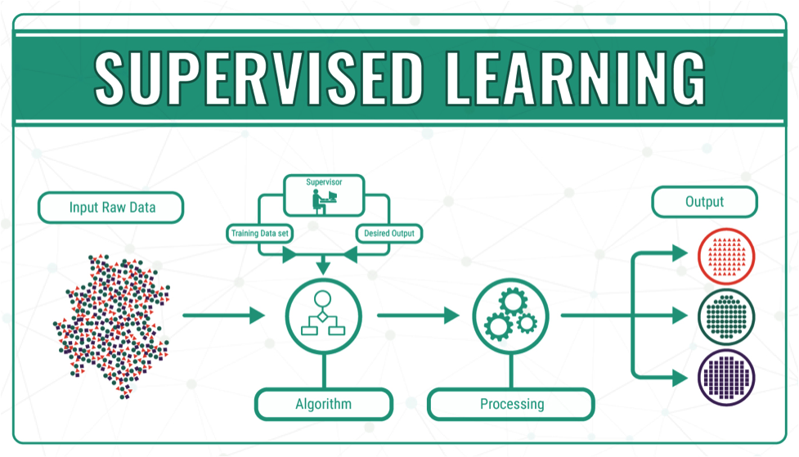
Notes:
https://datafloq.com/read/machine-learning-explained-understanding-learning/4478

Slide 15
Decision trees are used to group items by classification based on a set of features
Spectrum to Be Classified
Hε R Strength
Hβ R Strength
Hε L Strength
Hβ R Strength
Hδ R Strength
Hγ R Strength
Hε L Gamma
A
B
B
O
A
O
B
A

Slide 16
A Random forest classifier uses a series of randomly generated decision Trees
Spectrum to Be Classified
Random Forest
Tree-1
Tree-2
Tree-N
…
Class A
Class B
Class A
Majority Vote
Class A

Slide 17
four different labelling schemes were employed
Complete Classification | Complete Spectral Type | Spectral Type With Only Whole Number | Spectral Type Without Numerical Subtype
O9.5IV | O9.5 | O9 | O
B0.2III | B0.2 | B0 | B
A2III | A2 | A2 | A

Slide 18
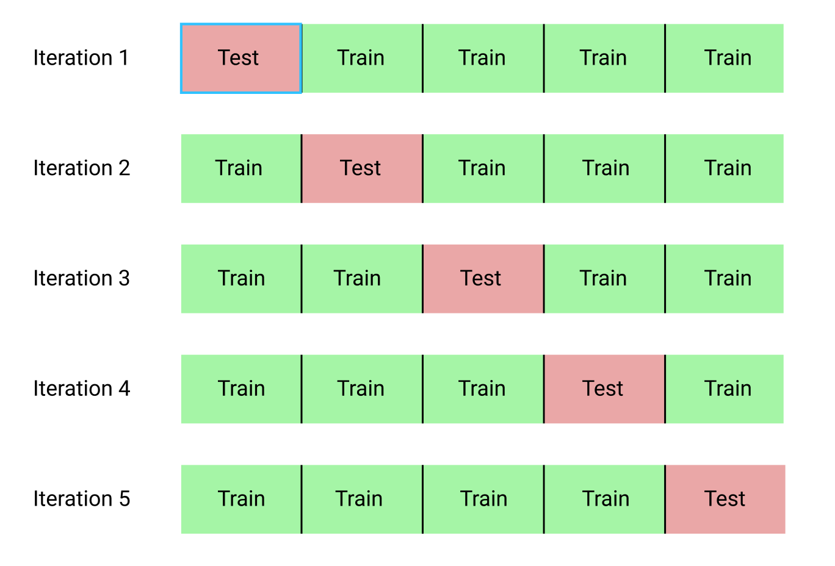
Cross validation is used to determine the true accuracy of a machine learning algorithm
http://i.imgur.com/gu3Fa6w.png
Notes:
http://i.imgur.com/gu3Fa6w.png

Slide 19
Classifier accuracy
Classifier Type | Accuracy | Type Version
RFC w/ K-Fold Cross-validation | 79% | Alpha Only
RFC w/ K-Fold Cross-validation | 28% | Whole Num
RFC w/ K-Fold Cross-validation | 23% | No Lumin
RFC w/ K-Fold Cross-validation | 24% | Complete

Slide 20
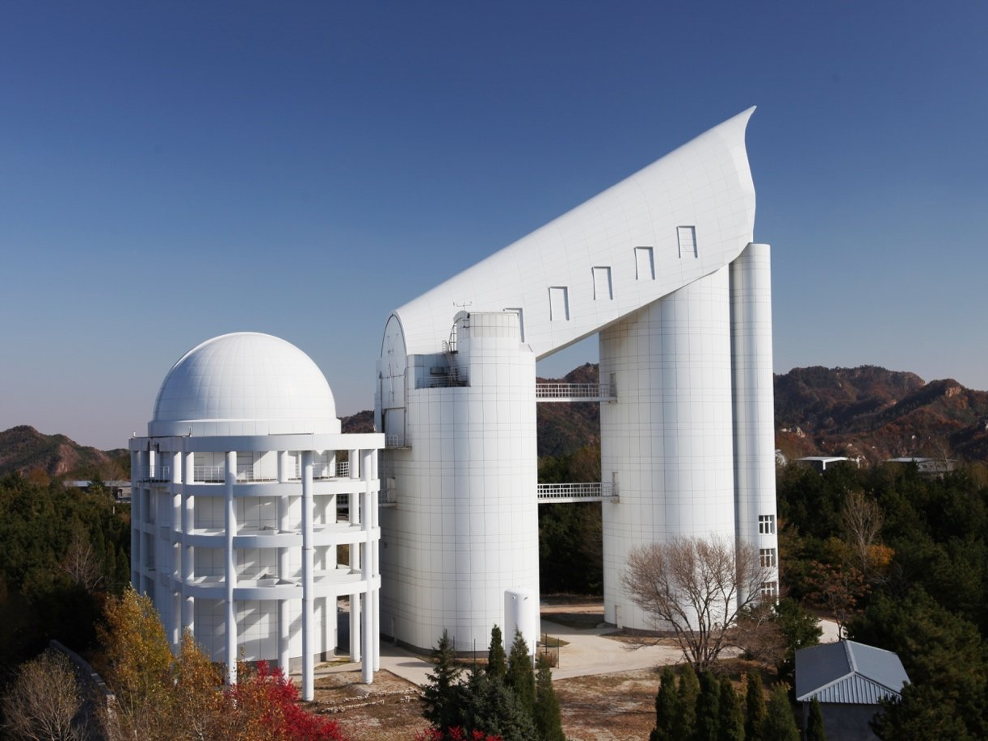
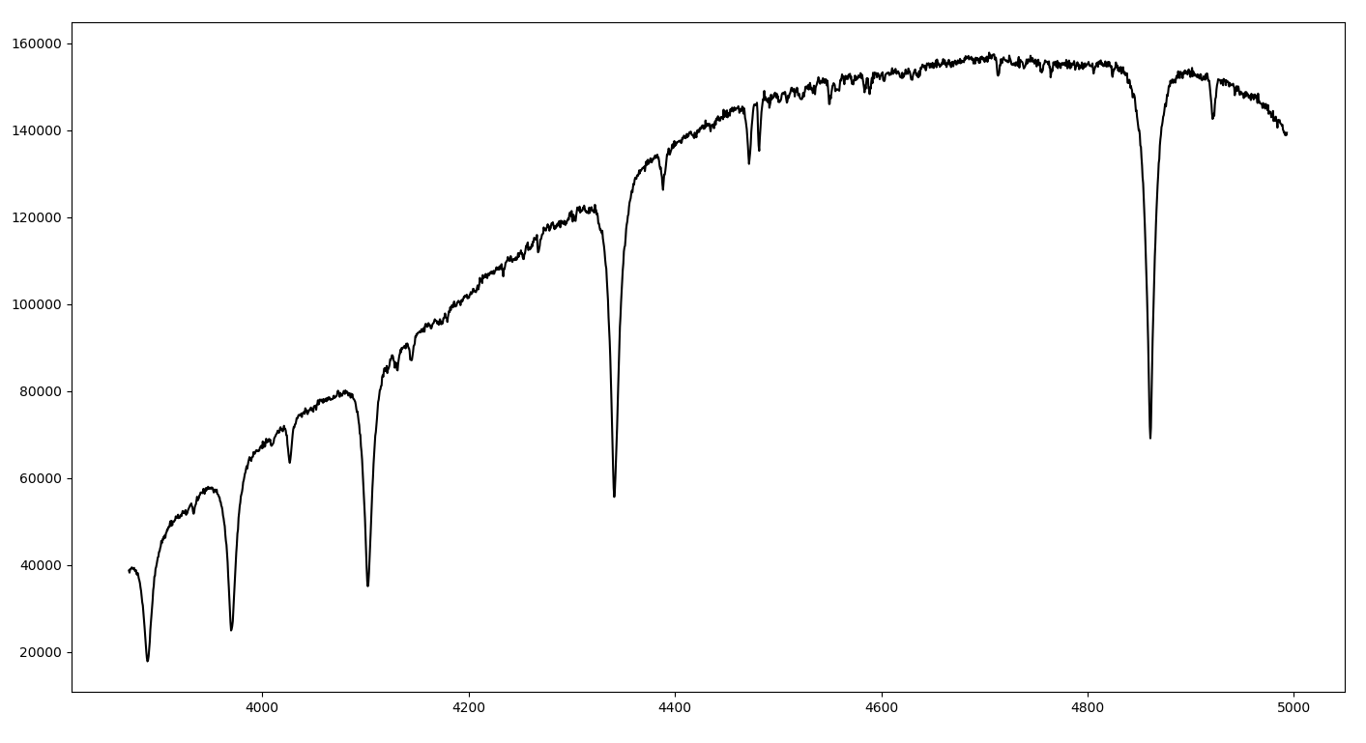
The low accuracy ratings for the more specific labels indicate more data is needed
Create new spectra from old spectra
LAMOST data from the Chinese Academy

Slide 21
the helium line Strengths are the next addition to the classification scheme
HD023288
He I
He I
He I
He I
120000
100000
He I
80000
He I
60000
40000
20000
4000
4200
4400
4600
4800
5000

Slide 22
A huge thank you to:
The John and Patricia Adams Foundation
Austin College
David Whelan
Mike Higgs

Slide 23
Questions?

